Slide 1
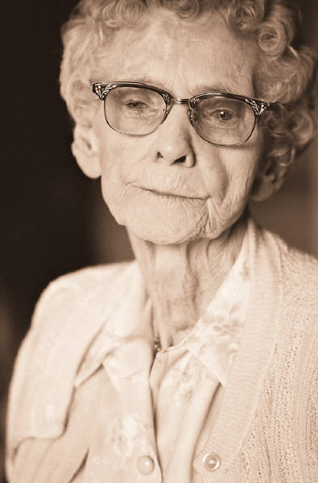
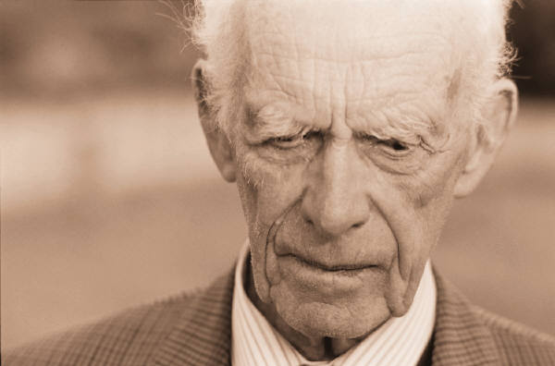
Beliefs and Stereotypes
Of the Elderly
Alaina Baker

Slide 2
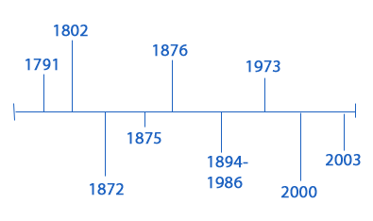
Throughout History
Throughout history the elderly have been victims of oppression, discrimination and stereotyping. As stated by Day (2009) age itself is a stereotype. At each milestone in our life we are judged based on our age. Ultimately our age determines our perceived capabilities. This oppression and discrimination over time has created stereotypes of the elderly; that with age, we become less capable and knowledgeable. This causes the elderly to be stigmatized by society and often discriminated against in the job market. With the growing life expectancy we are seeing more forced retirement among the elderly and jobs turned over to younger workers with growing families. According to Day (2009) “our societal emphasis on youth borders on geriatricide, in practice if not in intent.” For hundreds of years the value placed on youth has negatively affected the elderly, without a change in this ideation the elderly will continue to be unfairly forced out of work, offered petty benefits and a high percentage will remain below the poverty line.

Slide 3
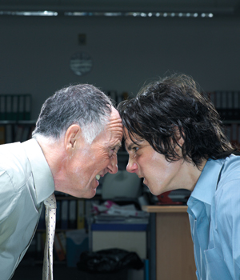
The Elderly Today
Today we continue to see this stigma and oppression against the elderly, even more so now than in the past. With the continued values and beliefs of today’s society being passed down from one generation to the next the elderly will continue to suffer unfair treatment. Many elderly men and women have worked for many years for the same employer, which in turn means they have earned a higher wage than someone just starting out. Employers today have began to offer perks to older workers in order to rush them into retirement even though the Older Workers Benefit Protection Act has made the forcing of retirement illegal. They do this in order to hire younger less experienced workers who will work for less pay even though it is proven that older workers are more reliable. As stated by Day (2009) “older workers have lower turnover rates, produce a steadier rate, make fewer mistakes, have more positive attitude toward their work, and exceed younger employees in health and low-on-the-job injury rates.” In forcing early retirement these elderly men and women are pushed out of their jobs and forced to live off of pensions, Social Security benefits and Medicare due to the fact that getting a job over 40 is challenging. Today, if a man or woman over the age of 40 was to seek a job, they would likely be looked over due to the fact that the stigma regarding age reflects that older workers are harder to train and their productivity will be limited as well as the fact that the cost for a company to insure a person increases at a certain age.

Slide 4
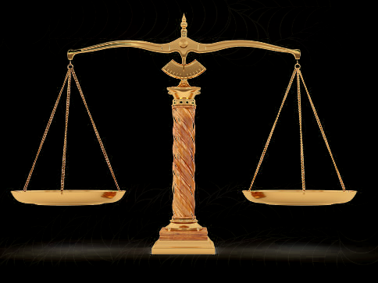
Treatment of the Elderly in the U.S.
In the United States we have laws to protect the elderly such as the Age Discrimination in Employment Amendments of 1986 which has eliminated mandatory retirement laws which in turn has caused a rise in the elderly remaining a part of the labor force well into their 60’s and 70’s. Although, according to Ashford & Lecroy (2010) growing technology has made the possession of competent technological skills mandatory in workers and the elderly are seen as incompetent in this area and “too old to learn” therefore they are not given equal opportunity. The elderly are able to receive assistance in the United States such as Social Security, although the amount of assistance is limited. Many elderly also qualify for Medicare, but those that don’t must rid themselves of practically every asset in order to qualify for necessary healthcare (Day, 2009). Also there are many housing opportunities offered in the United States to provide housing and assist the elderly in day to day activities. There is in home care available to those who wish to remain in their own home and there is indoor relief to those who require 24/7 assistance. Sadly, many older men and women in the United States fall victim to financial exploitation or theft because of the idea that the elderly are too old and naïve to notice. Overall there are laws in place to protect the elderly but there are still many ways in which they are oppressed and discriminated against.

Slide 5
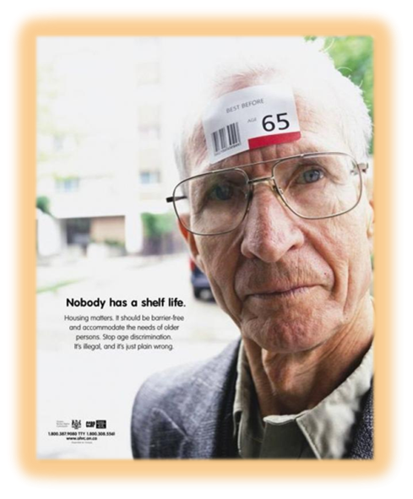
Types of Oppression Experienced by the Elderly
The elderly fall victim to legal, political, economic and educational oppression. Many laws exist in order to protect the rights of the elderly but fail to do so because of the mentality of society. In the case of John McCain running for President of the United States he was discriminated against based on his age, he was 71. According to (Public policy, perception, and resources of the elderly in today’s society, 2008) “voters group ageism with other “undesirable” traits in a presidential candidate, such as previous drug use, atheism, and being Muslim.” It is clear that the majority of the U.S. population view old age in a negative light. They feel that as you age you become less able and more feeble minded and therefore less desirable. With such discrimination the elderly are discouraged from many activities such as further education due to their perceived lack of learning abilities. This eventually becomes a self fulfilling prophecy for many elderly men and women because after being told they are inadequate redundantly they begin to believe it or act in a way that they feel others expect them to.

Slide 6
References
Public policy, perception, and resources of the elderly in today’s society. (2008, October 7). Retrieved from Foundations of Social Justice-Issues of Ageism and Elderly Oppression: http://swforelderly.wordpress.com/
Ashford, J. B., & Winston Lecroy, C. (2010). Human Behavior in the Social Environment: A Multidimensional Perspective.
Day, P. J. (2009). A New History of Social Welfare.

